Slide 1
ASP.NET Core Study Group Week 9
Model Binding and Validation
Select List Validation
AddSingleton, AddScoped vs AddTransient
WWCode

Slide 2

Part 41 – ASP.NET Core Model Binding

Slide 3
Model Binding Example
http://localhost:48118/home/details/2 Our application default route template ({controller=Home}/{action=Index}/{id?}) routes this request to Details(int? id) action method of the HomeController.
http://localhost:48118/home/details/2?name=pragim The following Details() action method handles the above request URL and maps the value 2 to the id parameter and the value pragim to the name parameter public string Details(int? id, string name) { return "id = " + id.Value.ToString() + " and name = " + name; }

Slide 4
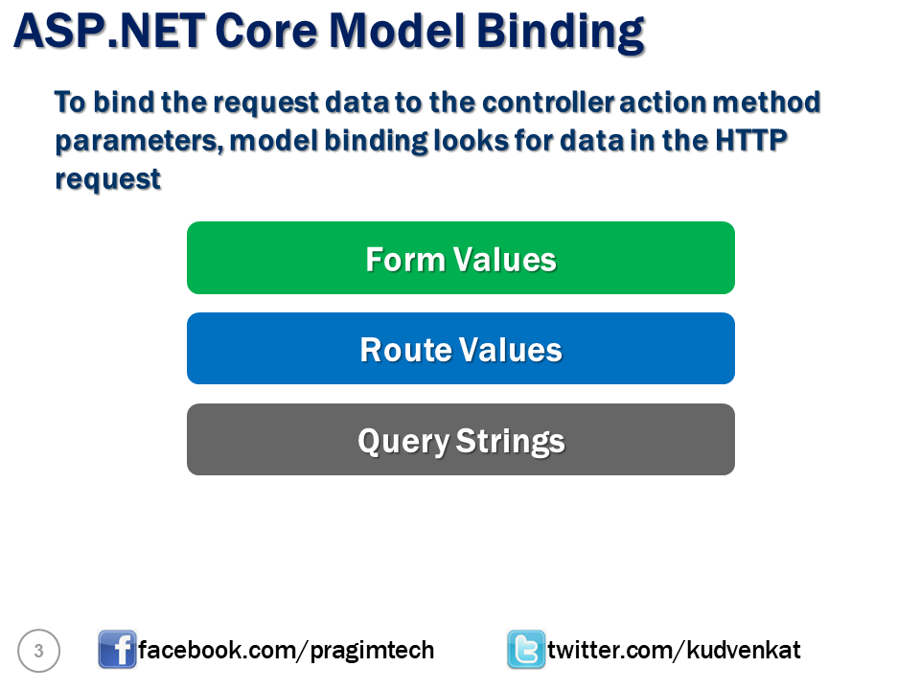

Slide 5
Model Binding with Complex Type
Browse to the Create View
Create another Create action method that takes an Employee object
Add Add() method to IEmployeeRepository, implement int EmployeeRepository, at the same time increment the max index as Id parameter of the new employee object.
Solve ambiguous methods
View source to show that Complex type’s properties are mapped to the form parameters directly
No validation

Slide 6
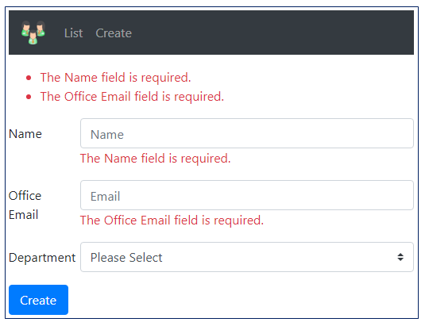
Part 42: ASP.NET Core Model Validation

Slide 7
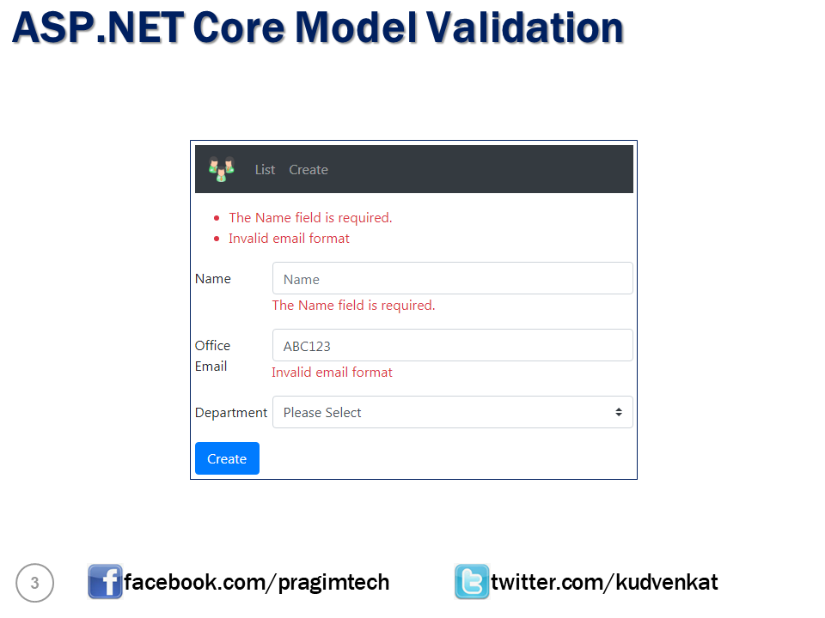

Slide 8
Built-in Validation Attributes
RegularExpression
Required
Range
MinLength
MaxLength
Compare

Slide 9
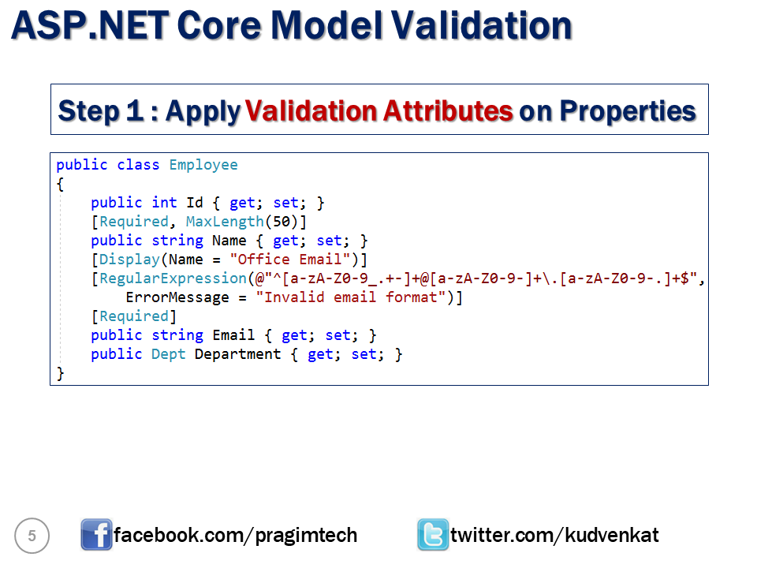

Slide 10
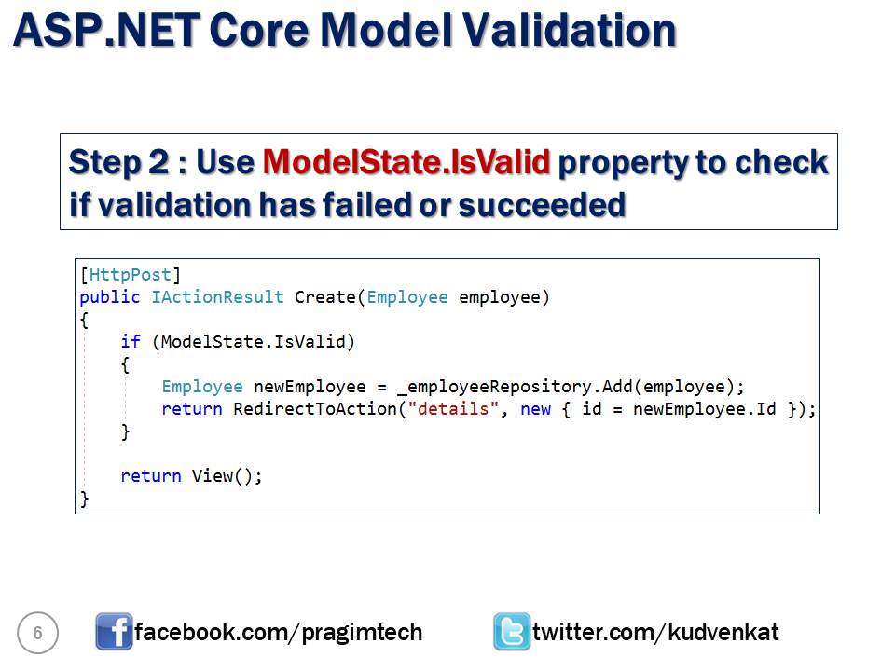

Slide 11
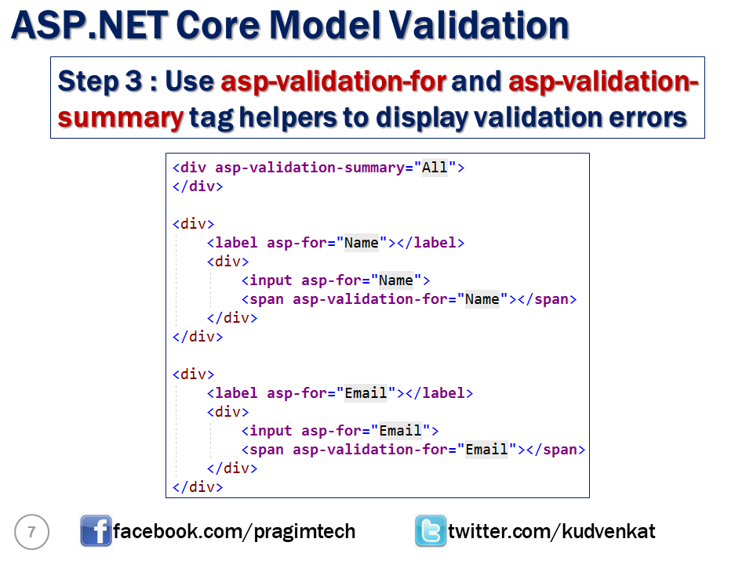

Slide 12
Customising Model Validation
Customising Model Validation Error Message
Use the ErrorMessage property in the Required attribute [Required(ErrorMessage = "Please provide a value for Name field")]
Customising Display Attribute
Use the Display attribute’s Name property [Display(Name = "Office Email")]
You can use multiple Model Validation Attributes one after another
Regular Expression [RegularExpression(@"^[a-zA-Z0-9_.+-]+@[a-zA-Z0-9-]+\.[a-zA-Z0-9-.]+$", ErrorMessage = "Invalid email format")]
class “text-danger” for Validation Errors Color

Slide 13

Part 43: Select List Validation

Slide 14
[Required] attribute with Enum and types like Integers
Enum underlying values are integers
Value types like integers are inherently “required”, you need to add the ‘?’ to mark them as optional

Slide 15
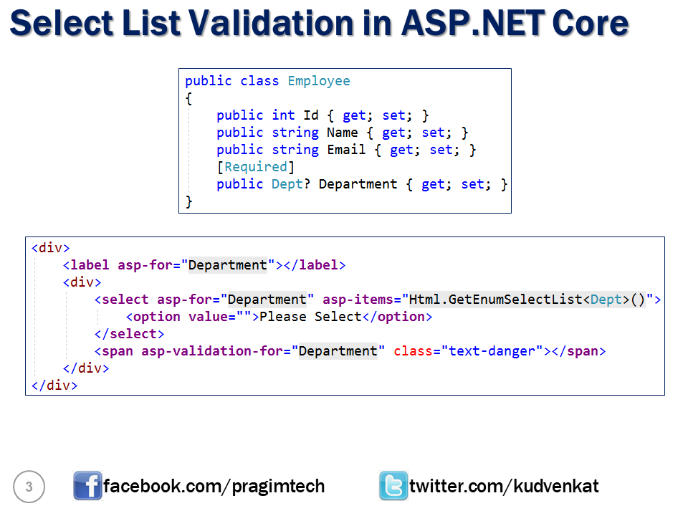

Slide 16

Part 44: AddSingleton, AddScoped vs AddTransient

Slide 17
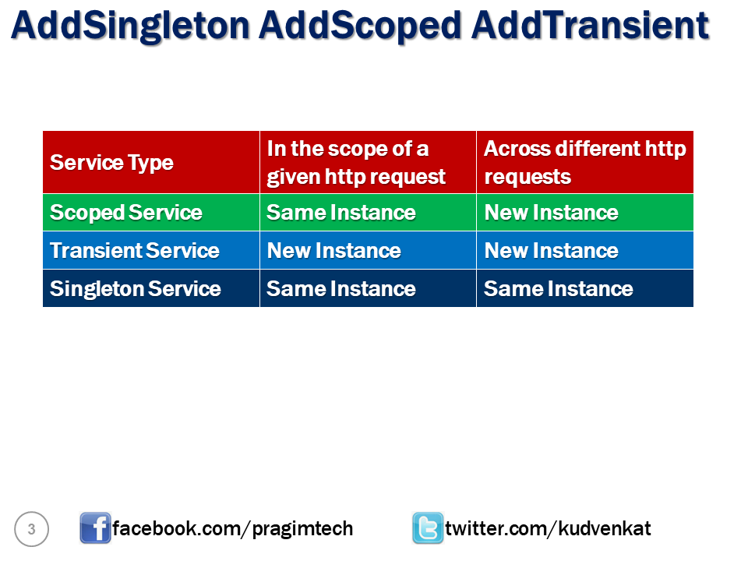

Slide 18
Credits
Thanks to Kudvenkat ASP.NET core tutorial for beginners https://www.youtube.com/playlist?list=PL6n9fhu94yhVkdrusLaQsfERmL_Jh4XmU
WWCode for the platform and wonderful supportive members who co-organized and participate in the study group, follow us here: https://www.meetup.com/wwcodekl/events/
Women Who Code YouTube channel contains lots of other recorded sessions: https://www.youtube.com/channel/UCfMEaBUSABoOsxr7HgSmEdA

